Slide 1
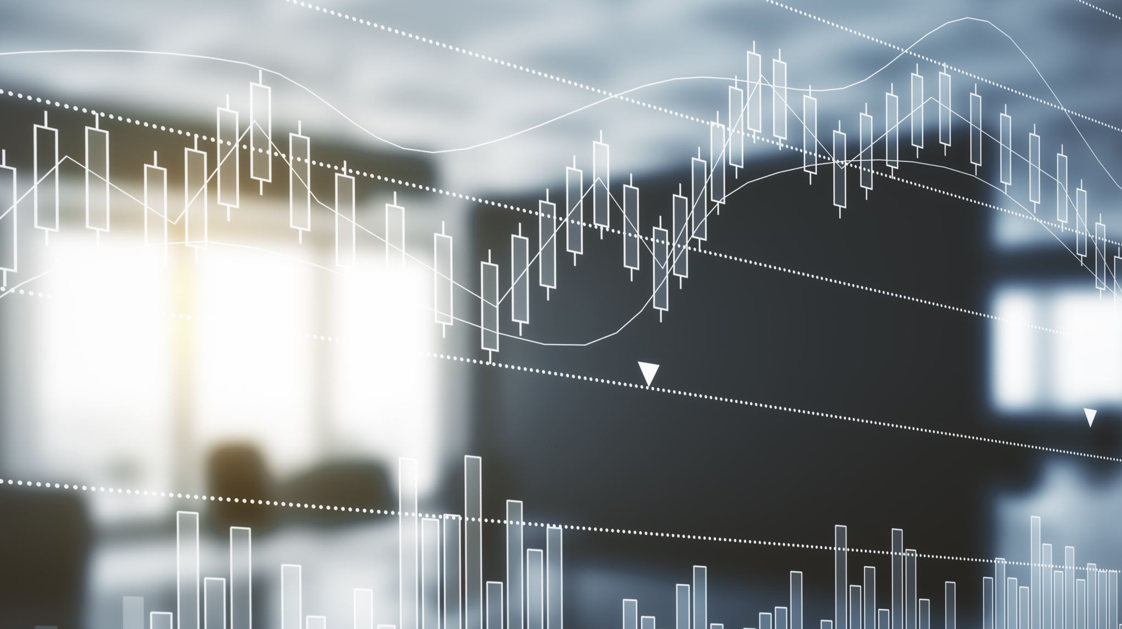
Stock Market Analysis using Hadoop Ecosystem
Jaisekhar Koya
Sri Sai Nikhil Kantipudi
Sai Rohith Guntupally
Arthi Nagireddy

Slide 2
Motivation
We have tried hard to study the stock market with graphs, news, important dates, and many more, but we failed many times which leads to loss of profits and sometimes even the investments. We always have an extremely hard time analyzing that huge amount of data and coming to a decision based on the analysis. And analyzing that huge data takes a lot of time and got to concentrate on various works too. So, to do this task for us we need some sort of Big data tools to analyze and give us filtered results which we can cross-check and invest in that stock confidently. Not only that as big data tools analyze data extremely fast, we can make decisions quicker than we do. We can also avoid human error using these tools.

Slide 3
Idea
The main idea of this project is to analyze the stock market with the help of stock market data and the social data(twitter data in this case) using Hadoop ecosystem.
This system collects the twitter data associated with the stock symbols and calculate the sentiment of the stock based on the user tweets.
Analyzing the live stream stock up’s and down’s using the google finance and python.

Slide 4
Significance
As more than half of the population are investing in stocks it is one of the most significant topics to be considered.
30% of investors failing to analyze the stock and predicting the uptrend or downtrend of stock is one of the major reasons.
Big data tools help to analyze the huge data which helps to provide the efficient results.
It reduces the analysis time of investors and helps in making decisions faster and error free.

Slide 5
Data set
Data Source: Twitter & Exchange
Time Period: 1 Month data
Tweets: 100k tweets
Stock Exchange data on excel sheet

Slide 6
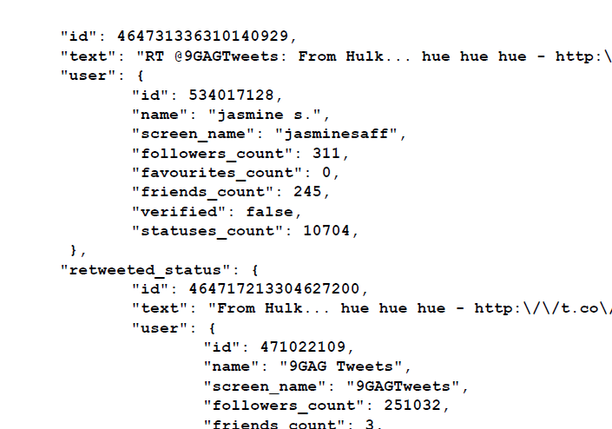
Tweet Objects
We are using the following Tweet Objects
Text
Text is the user Tweet
Entities
Contains Hashtags and URLs
User object
Contains user details like
- Time and date of the tweet
- Screen Name
- Followers Count

Slide 7
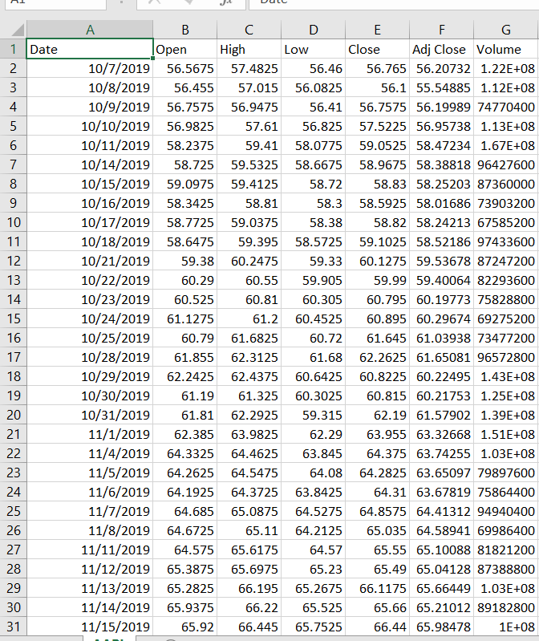
Static Data
Data is of one day interval for one month.
Important fields used in analysis are Open - Opening price of the interval High - High price it reached in that interval Low - Lowest price it reached in that interval Close - Closing price of that interval
volume

Slide 8
Storytelling
Who? Investors who play a lot with stock market will get helped with this system which makes their stock selection and timing effective.
What? Half of the investors are failing in stock selection with ineffective analyses.

Slide 9
Storytelling (contd.)
When? During investing in stock market on stocks by investors many people will loose their investment because of inaccurate approaches.
Where? Only in stock market this problem exists. There were different kinds of stock trading’s. But when it comes to the market, we got only one stock market with different exchanges.

Slide 10
Storytelling (contd.)
Why? People always wants to earn or save their money by buying shares in good company. But their selection of company or stock might be bad because of their process of analyses.
How? For example, if we take AAPL stock which belongs to apple. X likes the apple products so wants to invest in the company. So X bought the shares of AAPL stock. But what X don’t know is, at the same time Apple facing Bend Gate issue and stock just decreasing which bought loss to X. This system helps in analyzing the user opinions and helps in selection.

Slide 11
Tools and Technology
Python for Data Extraction
NLP techniques
MapReduce Jobs
HDFS to store the data
Apache spark to process the data
Hive & Cassandra for querying the data
Tableau for Data visualization

Slide 12
Objectives
we will be collecting the twitter data using NLP techniques and processing the data.
We compare the results with the previous behavior of movement of stock.
Different big data tools will be used to analyze the data and help in predicting the movement of the stock. (HDFS, Apache Spark and hive, all the operation on those tools)

Slide 13
Python live tracking
Using google finance function in excel sheet to return global stocks and indexes values directly into the excel sheet.
1
Updating the values of all the stocks live and reading it using python.
2
Comparing it with the proposed big data model results to check if predictions are accurate.
3
Estimating the impact of tweet news by change in stock percentage.
4

Slide 14
Applications
This model can be used as stock auto bot.
Can be used by the trader as a tool to analyze the stock
Used by stock analyst for prediction

Slide 15
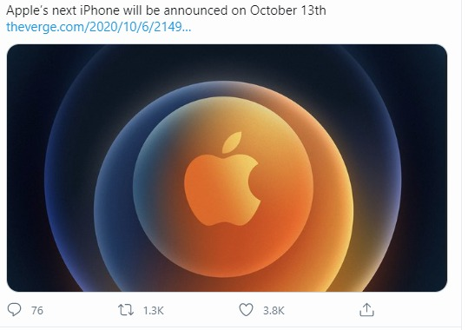
Applications (Contd.)

Slide 16
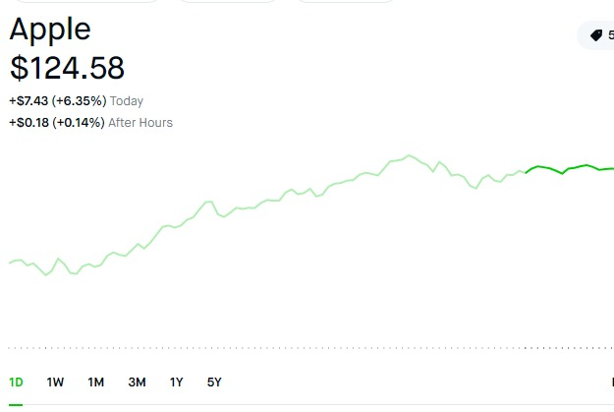
Applications (Contd.)

Slide 17
References
Z. Peng, "Stocks Analysis and Prediction Using Big Data Analytics," 2019 International Conference on Intelligent Transportation, Big Data & Smart City (ICITBS), Changsha, China, 2019, pp. 309-312, doi: 10.1109/ICITBS.2019.00081. •
G. V. Attigeri, Manohara Pai M M, R. M. Pai and A. Nayak, "Stock market prediction: A big data approach," TENCON 2015 - 2015 IEEE Region 10 Conference, Macao, 2015, pp. 1-5, doi: 10.1109/TENCON.2015.7373006.

